Slide 1
Social Media Engagement Analysis Dashbord
PRESENTED BY
KRISHNAPRIYA

Slide 2
Introduction
The objective of this project is to analyze social media engagement data and develop an interactive dashboard using Power BI.
The dashboard aims to visualize key engagement metrics such as likes, comments, shares, impressions, and reach across different social media platforms. By analyzing audience demographics, post types, campaign performance, and posting time, the project helps identify patterns and trends in audience interaction.
The goal is to transform raw social media data into meaningful insights that can support better marketing decisions and improve overall engagement strategies.

Slide 3
Problem Statement
Social media platforms generate large volumes of engagement data every day, including interactions such as likes, comments, shares, impressions, and reach. However, businesses and marketers often struggle to interpret this raw data and understand how their content performs across different platforms and audience groups.
Without proper visualization and analysis, it becomes difficult to identify the most effective content, campaigns, and influencers that drive higher engagement. Therefore, there is a need for a comprehensive dashboard that can analyze social media data and provide clear insights to improve marketing strategies.

Slide 4
Business problem
Which social media platform generates the highest engagement in terms of likes, comments, and shares?
How does engagement vary across different post types such as images, videos, and text posts?
How does engagement change over time based on date, weekday type, and time periods?
Which audience age group shows the highest interaction with social media posts?
How is engagement distributed between different audience genders?
How does sentiment (positive, neutral, negative) affect post engagement?
Which age group uses which social media platform the most?

Slide 5
Data overview
DATA FIELDS:
Platform
Post ID
Post type
Like, Comments,Shares
Audience Age Group
Audience Gender
Sentiment
Total Engagement
Date

Slide 6
Technology Used
Data Source:
Scial media Engagement Dataset (Excel file)
Data Preparation & Transformation (ETL):
Power Query: To clean, transform, and structure data
Data Modeling: Creating tables like Platform ,Sentiment ,Date ,Audience ,.
Data Analysis & Visualization:
Power BI :
Charts: Area chart, Bar chart, Column chart, Stacked area chart, Donut chart.
Measures using DAX.
Data Insights & Reporting:
Power BI Dashboard: Interactive visualizations for executives
Filters & Slicers: To analyze social media by Linked In ,Instagram ,Face Book ,Twitter

Slide 7
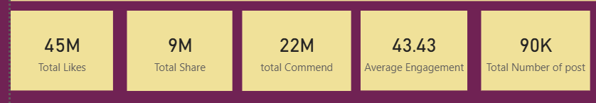
Key Matrics and KPI’s
.
.
.
.
.
Total Likes:
Total number of likes received across all social media posts.
Total Shares:
Total number of times posts were shared by users.
Total Commend
Total number of comments received on all posts
Average Engagement
The average level of interaction (likes, comments, shares) compared to reach.
Total Post
Total number of social media posts included in the dataset.

Slide 8
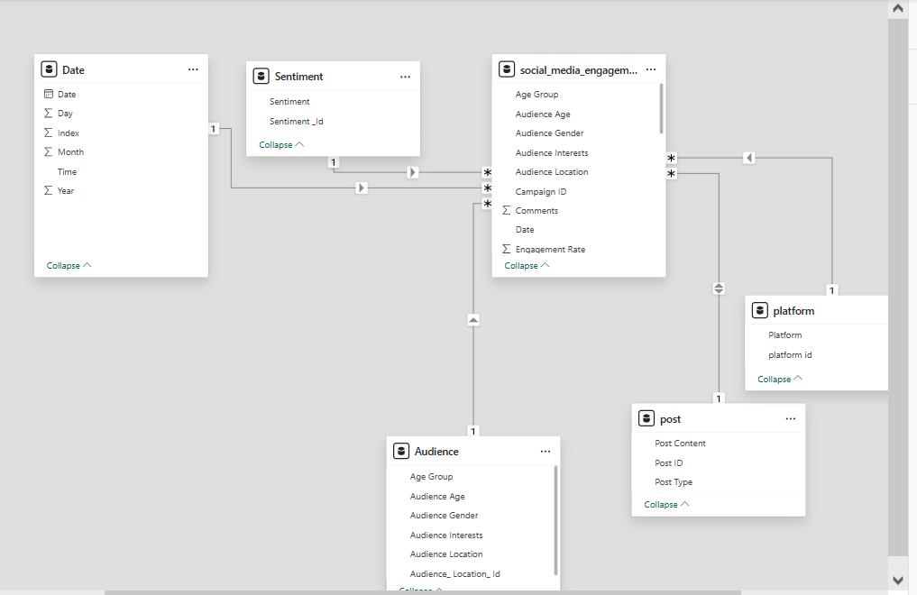
Data modelling -overview

Slide 9
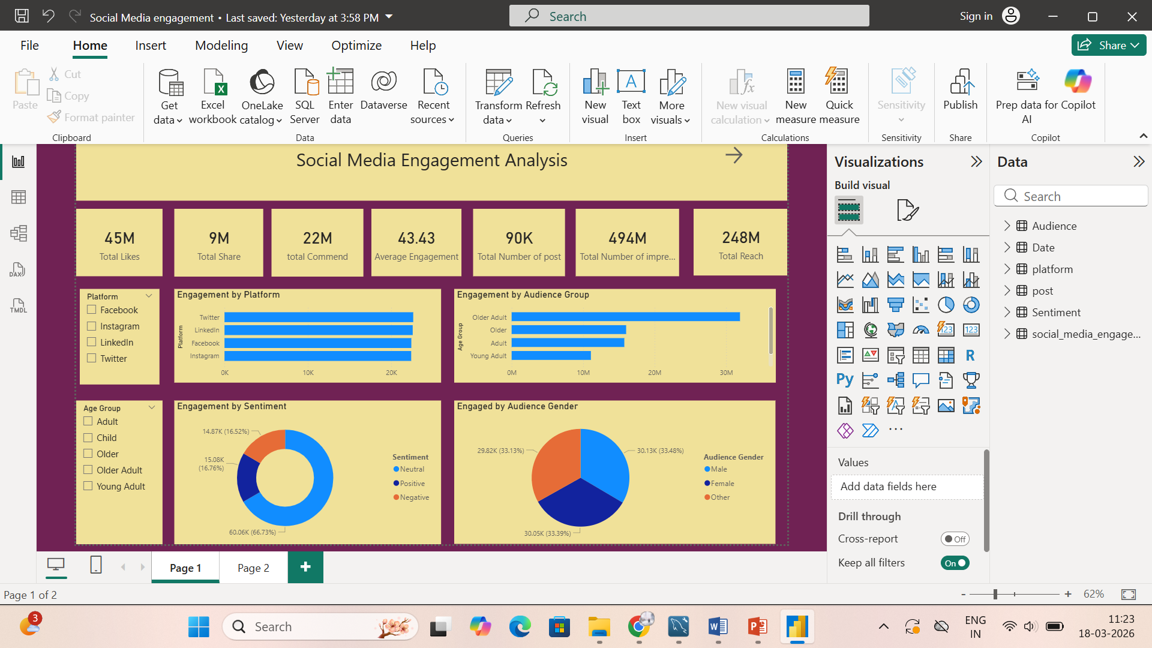
Power bi dashboard overview

Slide 10
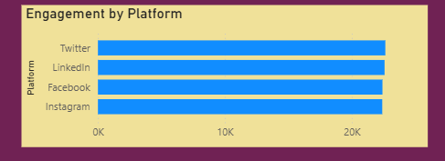
Which Social Media Platform Generates High Engagement
Analyzed engagement across different social media platforms
Engagement measured using likes, comments, and shares
Calculated total engagement for each platform
Compared performance of all platforms
Identified the platform with highest user interaction
X-axis : platform
Y-axis : totengagemental

Slide 11
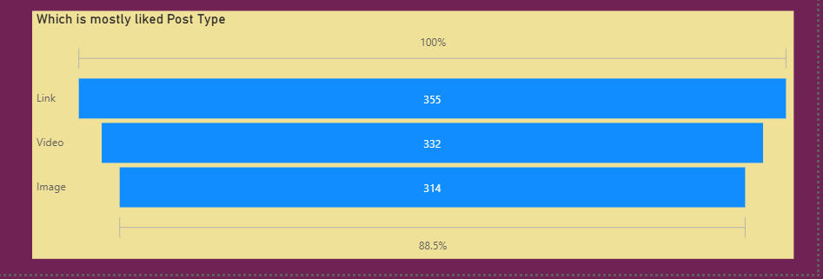
Which Post Has the Highest Engagement post
Analyzed engagement across different post types
Engagement measured using likes, comments, and shares
Calculated total engagement for each post type
Compared performance of image, video, and text posts
Identified the post type with highest engagement
X-axis : post
Y-axis : total engagement

Slide 12
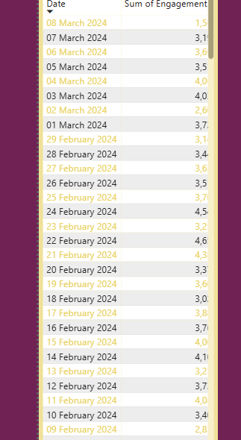
Engagement Change Over Time
Analyzed Engagement over Time using date
Engagement measured using likes, comments, And Shares
Help in optimizing content postin Schedule
X-axis : Date
Y-axis : total engagement

Slide 13
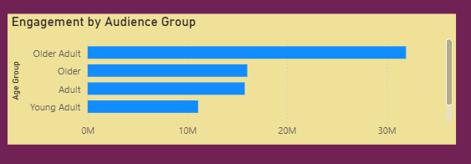
Which age have hightest engagement
Analyzed engagement across different age groups
Engagement measured using, likes, comments and shares
Calculated total engagement for each age group
Compared interaction levels between all age categories
X-axis : total engagement
Y-axis : age group

Slide 14
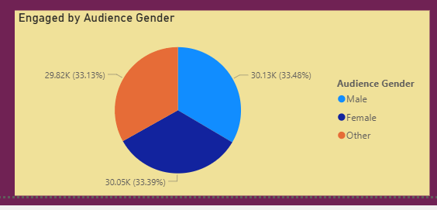
Which Gender Uses Social Media the Most
Analyzed social media usage across different genders
Calculate total interaction for each gender
Identified which gender is more active on social media
Help understand audience participation
Legens : Audience Gender
Values : total engagement

Slide 15
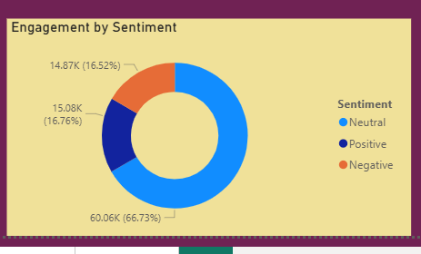
Does Sentiment Affect Post Engagement
Analyzed posts based on sentiment (positive ,netural,negative)
Measured engagement using like ,commends and shares
Identified which sentiment drives higher interaction
Legend : Sentiment
Values : Total Engagement

Slide 16
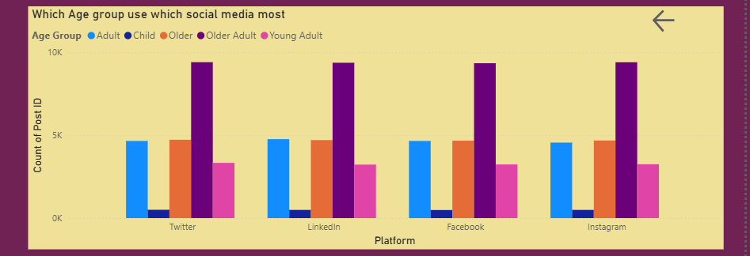
Which Age Group Uses Which Platform Mostly
Analyzed usage across age groups and social media platforms
Compared engagement using likes,comment and shares
Identified which age group prefers while platform
X-ais : platform
Y=ais : post
Legend : Age group

Slide 17
Conclusion
The Social Media Engagement Dashboard provides a comprehensive overview of social media performance by analyzing key engagement metrics and audience demographics. By visualizing data through interactive charts and graphs, the dashboard helps identify high-performing platforms, effective content types, and active audience segments.
These insights enable businesses and marketers to improve their social media strategies, optimize campaign performance, and make informed decisions based on data. Ultimately, the dashboard serves as a powerful tool for transforming complex social media data into actionable insights.

Slide 18
Thank you

